Slide 1
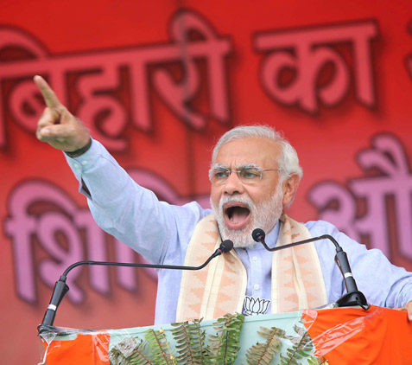
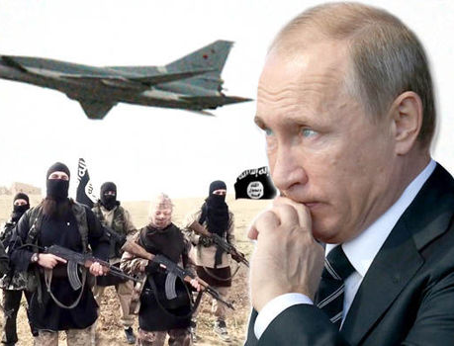
NEWS & WORLD
NEW DELHI, INDIA
WEEK OF OCTOBER 4-11, 2015
www.mediacenterimac.com
INDIA’S FAVOURITE NEWSPAPER
Vol.1 No.01
Modi Has 4% Lead Over Nitish-Lalu in Votes
Russia launches naval bombardment of targets in Syria
SACHIN SHUKLA, PATNA
The BJP-led alliance has a sizeable four percentage point lead over the Nitish Kumar-led Mahagathbandhan (grand alliance) in the upcoming Bihar state election - a largely bipolar contest – according to an exclusive opinion poll for The Times of India. Interestingly, there is this healthy lead for the challenger despite the survey showing respondents expressing a higher level of satisfaction with the performance of the state government led by Nitish Kumar than with the Narendra Modi government at the Centre.
BASANT SAINI, WASHINGTON
Russia launched a naval bombardment Wednesday of ISIS targets in Syria, a senior Russian official said, ramping up a newly muscular presence in the Middle East.
Four Russian ships fired 26 missiles into Syria, hitting 11 targets, Russian Defense Minister Sergei Shoigu told President Vladimir Putin during a televised meeting.
Shoigu said the strikes were launched from the Caspian Sea using precise long-range missiles that flew 1,500 kilometers (930 miles) to their targets.

Slide 2
NEWS & WORLD
WEEK OF OCTOBER 4-11, 2015
NATIONAL
www.mediacenterimac.com
SC seeks response from Centre and Delhi on toddlers’ plea to ban crackers
Manohar Parrikar to discuss women fighter pilots plan
PREETI , DELHI: IAF chief Air Chief Marshal Arup Raha on Thursday said that women will soon be able to fly combat fighter planes . He said this after reviewing the parade and flypast on IAF's 83rd anniversary at Hindon airbase on the outskirts of New Delhi. The IAF's proposal will be discussed at a meeting called by defence minister
Manohar Parrikar with the three Service chiefs next week. Till now, the Indian political leadership and military brass were stridently opposed to deploying women in combat roles, holding the country was not ready to deal with the grim possibility of its women being taken PoWs, tortured or raped in times of conflict.
MEA denies info through RTI on Netaji ‘war criminal’ query
SACHIN SHUKLA, NEW DELHI: The Supreme Court on Thursday sought responses from the Centre, Delhi government and Central Pollution Control Board (CPCB) on three toddlers' petition seeking ban on bursting of crackers this Diwali, saying its fumes would turn the Capital's already critically polluted air poisonous. A bench of Chief Justice H L Dattu and Justices Arun Mishra and Adarsh Goel sought responses from the governments and CPCB in a week but brushed aside repeated pleas from senior advocates Kapil Sibal, A M Singhvi and K K Venugopal for an interim stay on bursting of crackers.
BASANT, KOLKATA: The ministry of external affairs has ducked for cover to avoid "lethal" queries on the status of 'war criminal' tag given to Netaji by the Allied Powers in World War II. In response to an RTI application from Bengaluru-based freelance journalist Choodamani Nagendra, MEA has cited a clause in the RTI Act 2005 to deny information on Netaji. In the RTI application, Nagendra had asked six questions, all of them related to the 'war criminal' tag on Netaji. She wanted to know what efforts the Indian government had taken to remove Bose's name as war criminal from United Nations Organization records

Slide 3
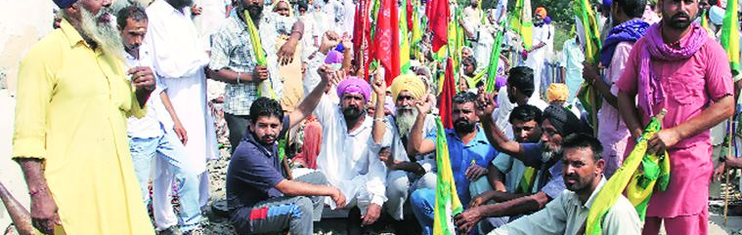
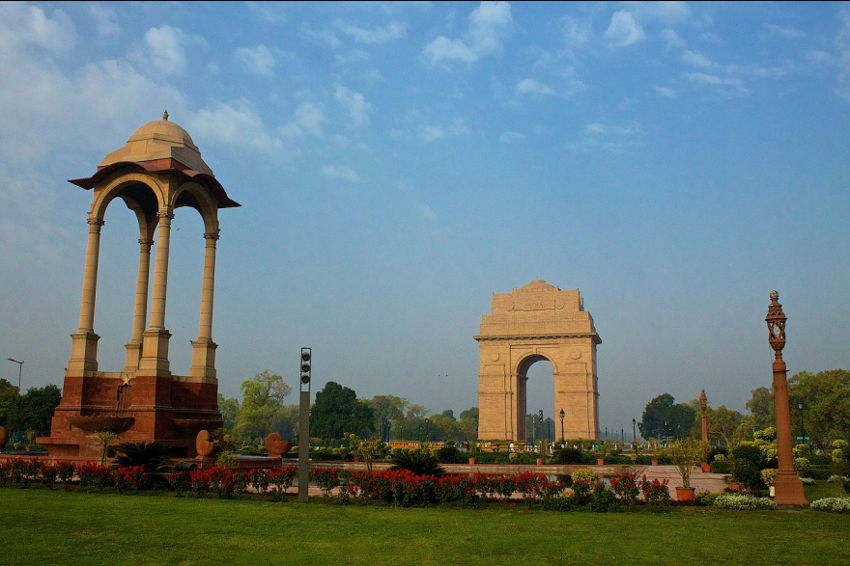
NEWS & WORLD
WEEK OF OCTOBER 4-11, 2015
NATIONAL
www.mediacenterimac.com
National war memorial: For 68 years, an idea in the works.
Cotton Crop Failure: Punjab protests extended by 2 days, 75 trains cancelled
Farmers protest on the railway tracks at Rampura Phul in Bathinda on Thursday. Gurmeet Singh Rail traffic will continue to be hit as farmers on Thursday decided to extend their rail roko for two more days, while also planning to block roads in a few districts of Punjab. Around 75 trains were cancelled on Thursday, the second day of the farmers’ protest, while 24 had to be diverted
J&K: MLA Engineer Rashid’s supporters detained during march to Assembly
SHIV, NEW DELHI: On Wednesday, the Union Cabinet approved a proposal for the construction of a national war memorial at India Gate. If all goes according to plan, the memorial, along with a war museum, will come up at Princess Park near India Gate in the next five years.
The Cabinet clearance is the closest the country has got to getting a national war memorial for its soldiers who have, since Independence, laid their lives while defending its frontiers. It’s a long pending proposal, almost as old as Independent India, and an emotive one too. Nobody understands this better than political parties who have used the demand for a war memorial as an election-time leverage, along with the One-Rank One-Pension demand.
Supporters of independent MLA Sheikh Abdul Rashid were today detained as he led a march towards Jammu and Kashmir Legislative Assembly to protest against the alleged “sabotaging” of the bill against beef ban.
Rashid along with his supporters assembled near Exhibition Crossing, near the civil secretariat here, and shouted slogans against the PDP-BJP government.

Slide 4
NEWS & WORLD
WEEK OF OCTOBER 4-11, 2015
STATES
www.mediacenterimac.com
Gorakhpur forgets Premchand on his 79th death anniversary
GORAKHPUR: Gorakhpur forgot one of its most illustrious citizen Munshi Premchand on Thursday. Not a single event was organized in memory of the most famous Hindi writer, who had passed away in Varanasi on October 8, 1936 at the age of 56. In his short life, he had penned over 14 novels and 300 short stories in Hindi and Urdu. Munshi Premchand had a long and vital connection with Gorakhpur and the city formed the centre stage of most of his writings. Encouraged by Mahatma Gandhi's speechat Bale Ka Maidan in the city, he quit government job in 1921 to join the freedom struggle
Metro will come to Nagpur for a price
NAGPUR: Most Nagpurians are excited over the metro rail but this ambitious project will come at a cost to them. Other than 1 per cent increase in stamp duty on property transactions, the Nagpur Metro Rail Corporation Ltd (NMRCL) is also seeking to levy a 10 per cent surcharge on property tax charged by Nagpur Municipal Corporation. It also wants to charge 10 per cent tax on premium of balcony, passage or stairs. Proposals in this regard will be sent to the urban development ministry.
Two CoBRA jawans injured in gun-battle with naxals
RAIPUR: Two CoBRA jawans were on Thursday injured in a fierce gunbattle between security forces and naxals in Chhattisgarh's insurgency-hit Sukma district, police said. The skirmish occurred in the restive Tetri forests under Bhejji police station limits when a
squad of CRPF's elite battalion-CoBRA (Commando Battalion for Resolute Action) was
carrying out an anti-naxal operation in the region, Sukma additional superintendent of police, Santosh Singh, said.

Slide 5
NEWS & WORLD
WEEK OF OCTOBER 4-11, 2015
STATES
www.mediacenterimac.com
Panchayat polls: SP leader booked for capturing booth in Mainpuri
An average day in Delhi: Six rapes, 14 molestations reported, say police data
GORAKHPUR: A Samajwadi Party leader and 14 others were booked for allegedly capturing a polling booth in the Mainpuri district during the second phase of panchayat elections on Tuesday (October 13). The FIR has been lodged against SP leader and the chairman of Uttar Pradesh Processing and Construction Cooperative Federation (PACCFED) Tota Ram Yadav and others at Bewar police station.
The FIR comes after a video went viral Friday, which showed Tota Ram allegedly stamping ballot papers in bulk at Raipur polling booth in Bewar block as poll staff and police remained mute spectators, SHO Narendra Singh said.
DELHI: Police data for the first nine months of this year shows that six rape and 14 molestation cases have been reported in the capital every day. Meanwhile, 364 rape cases of girls aged 10 and below were reported in 2013 and 2014, according to National Crime Records Bureau (NCRB) data. While NCRB data on crimes against children is not yet available for this year, child rights’ activists claimed that the crime rate against toddlers is on the rise. “The total number of cases registered by Delhi Police under the POCSO Act between December 2012 and March 2014 is 1,492. The maximum number of cases under POCSO Act were registered in the police district of Outer Delhi (226) followed by West (200) and Southeast (176),” said a senior police officer.
10 injured in cylinder explosion in Vikhroli
MUMBAI: TEN people were injured, three of them seriously, in an explosion caused by gas leaking from a domestic gas cylinder in a residential area in Vikhroli Friday. The injured included three teenagers of whom one sustained 80 per cent burns, officials said. According to Parksite police, the incident occurred around noon at the residence of Vimal Chavan (50). The police said the family stays in a ground-plus-one structure in Varsha Nagar area in Parksite, Vikhroli (east).
“The LPG cylinder in Vimal’s house had run out of gas, and she borrowed a spare cylinder from her neighbour. While she was connecting the cylinder to the stove, she smelled gas and went to tell her neighbour there was a possible leak. As soon as she returned to her house after the conversation, there was an explosion. We believe it could have been caused after the leaking gas came in contact with a spark or a flame,” said Senior Police Inspector Rajendra Kulkarni, Parksite police station.

Slide 6
NEWS & WORLD
WEEK OF OCTOBER 4-11, 2015
MY CITIES
www.mediacenterimac.com
Gorakhpur forgets Premchand
on his 79th death anniversary
GORAKHPUR: Gorakhpur forgot one of its most illustrious citizen Munshi Premchand on Thursday. Not a single event was organized in memory of the most famous Hindi writer,
who had passed away in Varanasi on October 8, 1936 at the age of 56. In his short life, he had penned over 14 novels and 300 short stories in Hindi and Urdu. Munshi Premchand had a long and vital connection with Gorakhpur and the
city formed the centre stage of most of his writings. Encouraged by Mahatma Gandhi's speech at Bale Ka Maidan in the city, he quit government job in 1921 to join the freedom struggle
Two CoBRA jawans injured in gun-battle with naxals
Metro will come to Nagpur for a price
NAGPUR: Most Nagpurians are excited over the metro rail but
this ambitious project will come at a cost to them. Other than
1 per cent increase in stamp duty on property transactions, the
Nagpur Metro Rail Corporation Ltd (NMRCL) is also seeking to levy a 10 per cent surcharge on property tax charged by Nagpur Municipal Corporation. It also wants to charge 10 per cent tax on premium of balcony, passage or stairs. Proposals in this regard will be sent to the urban development ministry.
RAIPUR: Two CoBRA jawans were on Thursday injured in a fierce gunbattle betweensecurity forces and naxals in Chhattisgarh's insurgency-hit Sukma district, police said. The skirmish occurred in the restive Tetri forests under Bhejji police station limits when a squad of CRPF's elite battalion-CoBRA (Commando Battalion for Resolute Action) was
carrying out an anti-naxal operation in the region, Sukma additional superintendent of police,Santosh Singh, said.

Slide 7
NEWS & WORLD
WEEK OF OCTOBER 4-11, 2015
BUSINESS
www.mediacenterimac.com
Jan-Dhan gets service tax relief
IT has not cut banks' costs: Rajan
The government has extended the service tax exemption to Jan Dhan Yojana (JDY), PM Narendra Modi's pet project for financial inclusion. Last fiscal, the exchequer had collected about Rs 100 crore but an ambiguity in tax rules forced JDY service providers, mainly banking correspondents, to pay 14% tax for their services in the area. This slowed down the spread of the JDY scheme as facilitators for banks where there were no branches had to incur higher tax outgo.
Reserve Bank of India governor Raghuram Rajan has questioned the pricing of IT deals that banks have entered into. Pointing out that the IT revolution has not brought down expenses for banks, Rajan said this could be because the structure of fees is such that cost reduction is not reflected in the bottom line. He also said that banks need to restructure and branches cannot be run as they were during the days of the ledger system.
Volvo's profit doubles
Take over errant sugar mills: Centre to UP govt
Global manufacturer Volvo saw profits double in the third quarter compared to the same period last year, according to the earnings posted by the group. The Swedish truck and construction manufacturer saw sales rise to 73.3 billion SEK ($8.61 billion), a nine percent increase on the same period in 2014, and raised its forecast for the European truck market this year, Xinhua news agency cited a statement as saying on Friday. "We continue to strengthen our profitability in the third quarter of the year," acting CEO Jan Gurander said, though he noted that total sales increased only one per cent when adjusted for currency movements.
MEERUT: Union minister of state (MoS) for agriculture Sanjeev Balyan on Thursday said his ministry has told the Prime Minister that they aim to export at least 4 million tons of sugar this year to help reduce the surplus of 11 million tons. Balyan also advised the state government to to take over mills such as Mawana and Modi mills that are failing at payment of cane arrears to farmers. He said UP has a lot to learn from its neighbor Haryana, which has ensured 100% payment of sugarcane dues.

Slide 8
NEWS & WORLD
WEEK OF OCTOBER 4-11, 2015
EDITIORIAL
www.mediacenterimac.com
DALIT as easy Targets
PREETI BHANOT, FARIDABAD
The murder of two children of a Dalit family in Faridabad is part of a disturbing pattern of violence against the Scheduled Castes in Haryana. National Crime Records Bureau data put the number of incidents of crimes against Dalits in Haryana in 2014 at 830. The corresponding figure for 2013 was 493; for 2012 it was 252. Haryana has often been in the news for all the wrong reasons so far as the question of caste-related incidents are concerned. It has witnessed many major atrocities on Dalits before — including the Jhajjar killing of five Dalits in 2002, the burning of Dalit houses in Gohana in 2005, and the killing of two Dalits at Mirchpur in 2010. These atrocities apart, the State has been notorious for its Khap (clan) panchayats that have hit out against marriages outside a given caste or within a clan. Successive State governments including the present one led by the Bharatiya Janata Party have been unable to show the resolve to confront such tendencies up front. Political leaders have generally shied away from questioning the regressive aspects of tradition in the State. However, Haryana isn’t the lone culprit where violence against Dalits is concerned. NCRB data show high incidence of such atrocities in States such as Uttar Pradesh, Rajasthan, Bihar and Madhya Pradesh, among others.
Despite two crucial laws to deal with crimes against Dalits – the Protection of Civil Rights Act, 1955, and the Scheduled Castes and Scheduled Tribes (Prevention of Atrocities) Act, 1989 – the high incidence of violence against them is disturbing. While this shows the social vulnerability of Dalits even decades after reservation and dedicated laws meant to uplift and empower them were put in place, the gradual improvement in their material status may in fact have led to a rise in atrocities. For, increased Dalit independence and assertion are not to the liking of the dominant castes, especially in the countryside. There is little doubt that the rise of a middle class among Dalits since Independence — thanks largely to the reservation policy — has made these issues politically sensitive. With Dalits emerging as a pressure group constituting about 16 per cent of India’s population, any such incident leads to a political outcry. One such was witnessed on October 21 when Congress leader Rahul Gandhi visited the village and political leaders in poll-bound Bihar tweeted about it. Their votes have made the voice of the Dalits matter to an extent. But all this is still primarily at the level of political discourse; more needs to happen on the ground.

Slide 9
NEWS & WORLD
WEEK OF OCTOBER 4-11, 2015
INTERNATIONAL
www.mediacenterimac.com
Bangladesh police arrest 4 suspects in killing of Italian
Tony Blair admits 2003 Iraq invasion led to rise of ISIS, apologizes for mistake
Police say they have arrested four suspects in last month’s killing of an Italian citizen in the Bangladeshi capital. talian aid worker Cesare Tavella was gunned down by motorcycle-riding assailants while jogging on the streets of the Dhaka’s diplomatic quarter. Responsibility for the attack was claimed by the Islamic State group, but the Bangladeshi government denied the extremist Sunni militant group had any presence in the impoverished South Asian nation.
Balkan, EU leaders pledge to work
together on migrant crisis
Former British Prime Minister Tony Blair acknowledged the 2003 invasion of Iraq played a part in the rise of the Islamic State militant group, and apologised for some mistakes in planning the war, in an interview broadcast on Sunday.
Blair’s decision to send troops to back the US-led invasion is still a live political issue in Britain, where a six-year public inquiry into the conflict is yet to publish its findings.
Asked whether the offensive was the principal cause of the rise of Islamic State, which now controls large areas of Iraq and neighbouring Syria, Blair said there were “elements of truth” in that. “Of course, you can’t say that those of us who removed (former Iraqi dictator) Saddam (Hussein) in 2003 bear no responsibility for the situation in 2015,” Blair told US network CNN. Critics say the US decision to disband Saddam Hussein’s army after the invasion created a huge security vacuum exploited by al Qaeda, which was eventually replaced by Islamic State.
European leaders agreed to cooperate to manage migrants crossing the Balkans but offered no quick fix to a crisis that threatens to take more lives as winter sets in and to set Europe’s nations against one another.
Meeting in Brussels as another woman and two children died at sea off Turkey, German Chancellor Angela Merkel and Greek Prime Minister Alexis Tsipras met leaders of nine countries on the route from the Aegean to Germany taken this year by half a million people, defying EU borders and unfurling razor wire.

Slide 10
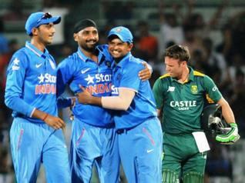
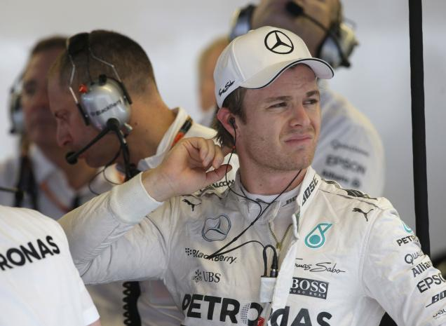
NEWS & WORLD
WEEK OF OCTOBER 4-11, 2015
SPORTS
www.mediacenterimac.com
Harbhajan still hungry for more
Nico Rosberg fastest in F1
practice for US Grand Prix
Harbhajan’s still at it, still producing deliveries that defeats the batsmen. At 35, he’s still got the hunger.
Amidst fading light, Glenn McGrath pounded in. A Test series was on a knife’s edge. The M.A. Chidambaram Stadium was a cauldron.
A sea of spectators held their breath as Harbhajan Singh settled in his stance. The pressure was at tipping point. The decisive moment was around the corner.
McGrath released a fuller length ball, Harbhajan sliced him past point and the crowd erupted. India had nailed a cliff-hanger by two wickets. A remarkable series against Steve Waugh’s gallant men had been won 2-1.
Although his final act was with the bat, Harbhajan had claimed a remarkable 32 wickets in the three Tests with his off-spin. He scalped batsmen in a hurry, turned matches on their heads. That was a long time ago.
.
When the rain came, all Lewis Hamilton could do was wait.
And wait. And wait. And then hope all this rain won’t impact his world title hopes. Torrential rain and lighting forced race officials to cancel the afternoon practice session when it was determined the medical helicopter at the Circuit of the Americas would not be able to fly in the poor conditions.
Storms could affect the entire weekend, from qualifying Saturday to the race Sunday. “I don’t think I’ve ever seen it rain like this,” Hamilton said. “We’ve got very little information to work with now, so the rest of the weekend will be very intense.” In the morning session, the cars sent towering plumes of wet spray behind that limited visibility early on. Even when he was by himself, Hamilton nearly spun around his back end as he braked into a corner.

Slide 11
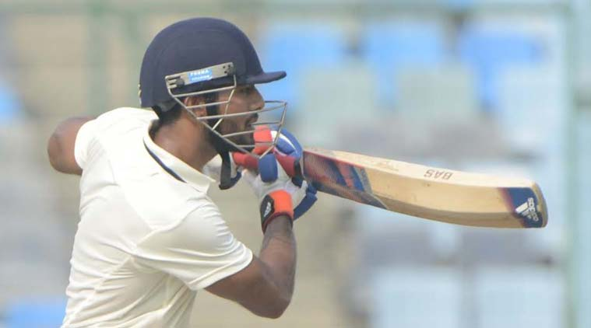
NEWS & WORLD
WEEK OF OCTOBER 4-11, 2015
SPORTS
www.mediacenterimac.com
Delhi in spot of bother after Bengal post 357
Delhi looked in some sort of discomfort at home turf for the first time this season as they reached 100 for three in reply to Bengal’s 357 on the second day of their Ranji Trophy group league cricket encounter, in New Delhi on Friday. On a tricky Kotla surface with variable bounce, Ashoke Dinda (1-27) removed Gautam Gambhir (0) leg before in the very first over as the India discard was beaten for pace. Veteran left-arm spinner Pragyan Ojha (1/28) then dismissed Gambhir’s deputy Unmukt Chand (13) with a ball that kept low and caught him plumb in-front.
Real Madrid play out goalless draw, Manchester City register late win
Cristiano Ronaldo and Zlatan Ibrahimovic struggled as Paris Saint-Germain and Real Madrid played to a lackluster 0-0 draw in the Champions League on Wednesday, while Manchester City found a way to earn a late 2-1 victory in a thrilling finish against Sevilla.
Atletico Madrid, Wolfsburg and Galatasaray all won, while Manchester United could not manage more than a 1-1 draw at CSKA Moscow and Juventus was held to a scoreless home draw with Borussia Moenchengladbach.
There was a lot of talk about Ronaldo and Ibrahimovic ahead of the high-profile match at the Parc des Princes, but neither player made an impact and the teams left with a point each to remain comfortably ahead in Group A.

Slide 12
NEWS & WORLD
WEEK OF OCTOBER 4-11, 2015
ENTERTAINMENT
www.mediacenterimac.com
Harry Potter coming back, this time on stage in new play
'Harry Potter and the Cursed Child', a two-part stage play, will be a sequel to the original series and is set 19 years after the end of 'Harry Potter and the Deathly Hallows'.
The theatrical event is billed as the eighth part of the series. It is based on a new story by J.K. Rowling, local media reported.
The synopsis read: “It was always difficult being Harry Potter and it isn’t much easier now that he is an overworked employee of the Ministry of Magic, a husband and father of three school-age children. While Harry grapples with a past that refuses to stay where it belongs, his youngest son Albus must struggle with the weight of a family legacy he never wanted. As past and present fuse ominously, both father and son learn the uncomfortable truth: sometimes, darkness comes from unexpected places.”
Shaandaar: Beautiful to behold, but Shallow
Shaandaar, you could say, is about two marriages. The first one is between two families, the Aroras and the Fundwanis, who come together for the wedding of Esha Arora (Sanah Kapoor) and Robin Fundwani (Vikas Verma). The second one is the marriage of two worlds of Hindi cinema — Karan Johar’s Dharma Productions and Anurag Kashyap’s Phantom Films. While we expect the Johars to bring in the glamour, we leave the grit and the depth to the Kashyaps (also the Motwanes and the Bahls) who we also trust with keeping the proceedings grounded. On paper, this appears to be a match made in heaven. Who wouldn’t want to see great production value in a realistically told family tale about finding comfort in being yourself? But like the Indian cricket team’s batting line-up, it’s good on paper but needn’t necessarily translate to victory. In fact, here, like the marriage between Esha and Robin, it seems doomed right from the start.

Slide 13
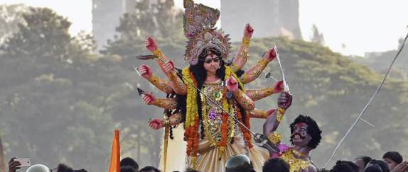
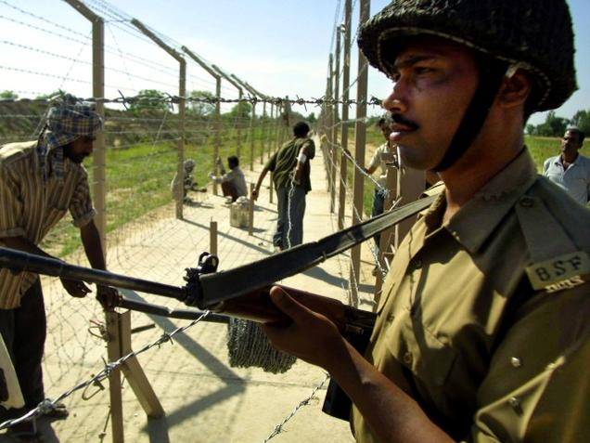
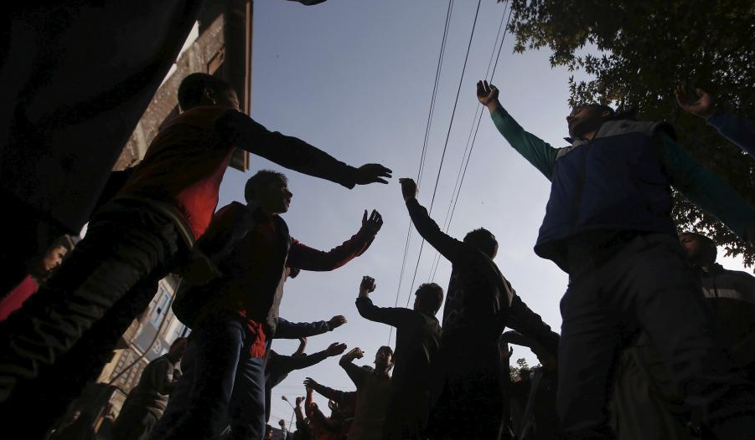
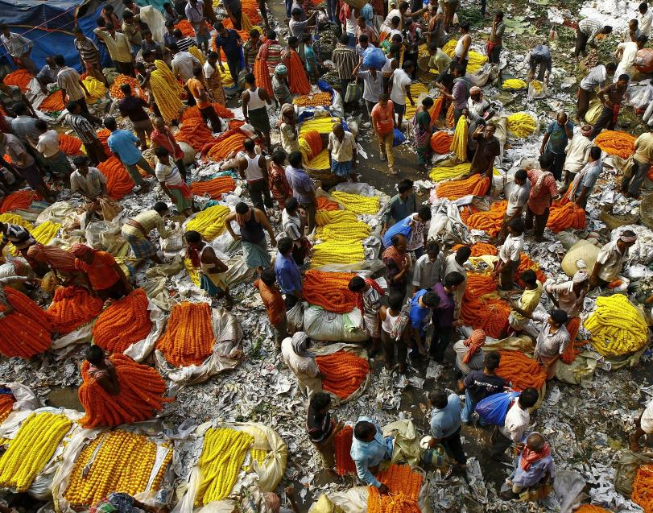
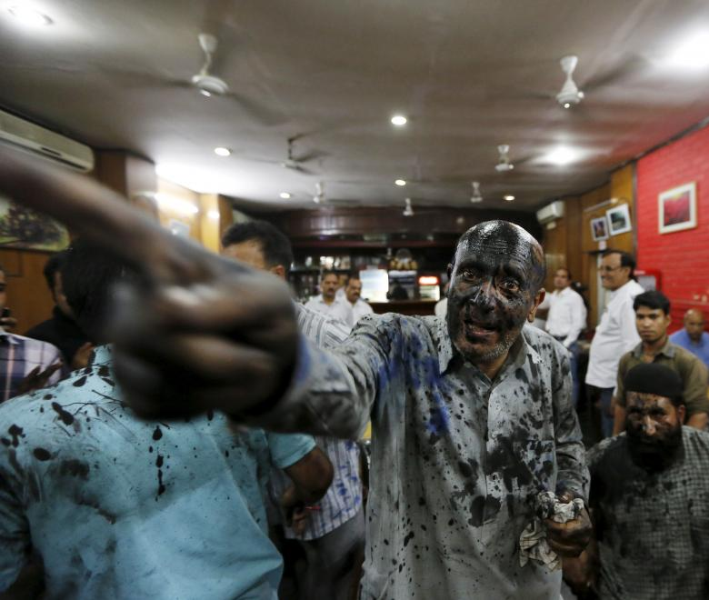
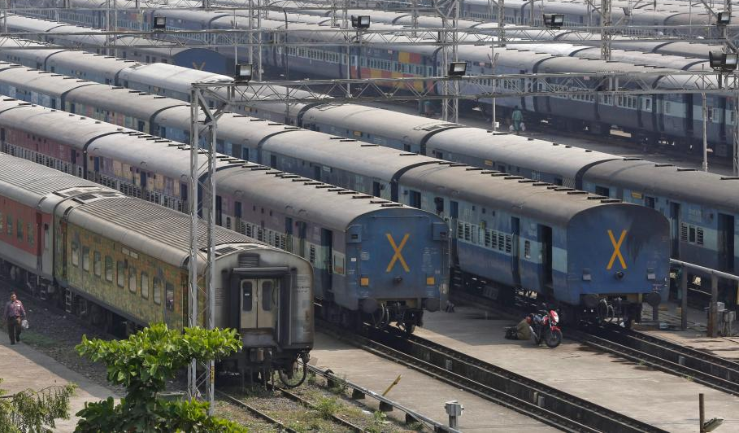
NEWS & WORLD
WEEK OF OCTOBER 4-11, 2015
NEWS IN PICS
www.mediacenterimac.com

